Slide 1



Slide 2

Table of Content
Company Information
Office Location
About US
Project Portfolio
Project Information
Team & Task Division
Project Statement
Project Details
Unit-4 Details
Units List
Supplemental Information
Appendix

Slide 3
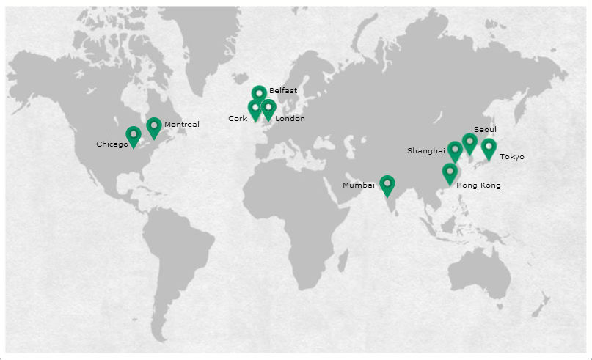
Locations
Chicago
Montreal
London
Cork
Belfast
Tokyo
Hong Kong
Shanghai
Seoul
Mumbai

Slide 4

About Us
Catalyst is a North America-based, international construction services company and is a leading builder in diverse and numerous market segments. The company has earned recognition for undertaking large, complex projects, fostering innovation, embracing emerging technologies, and making a difference for their clients, employees and community. With a staff of 5,200 employees who work on more than 1,500 projects each year, we offer clients the accessibility and support of a local firm with the stability and resources of a multi-national organization.
OUR VISION To be the highest value provider of global construction services and technical expertise.

Slide 5
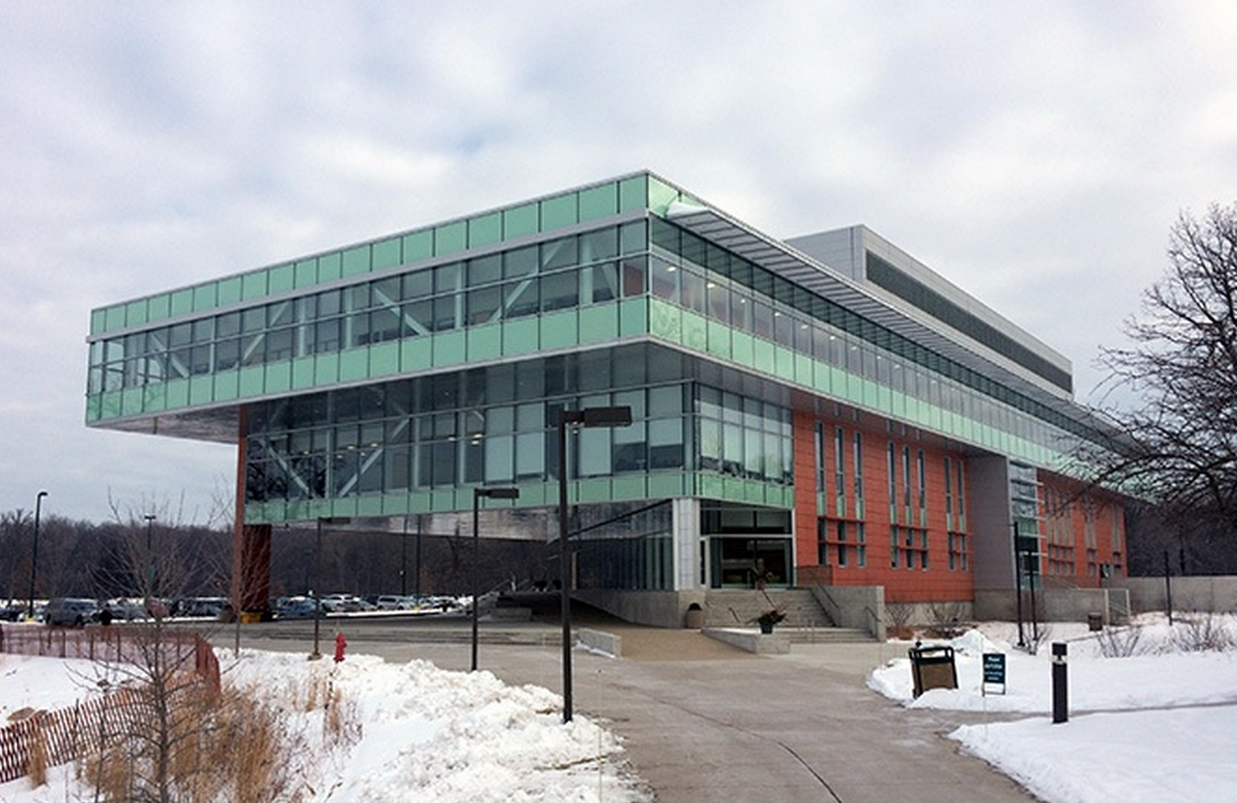
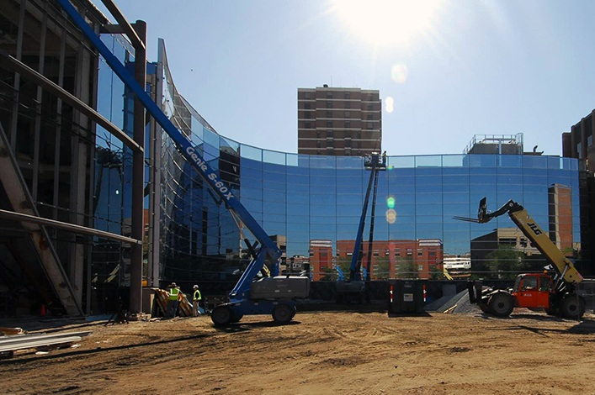
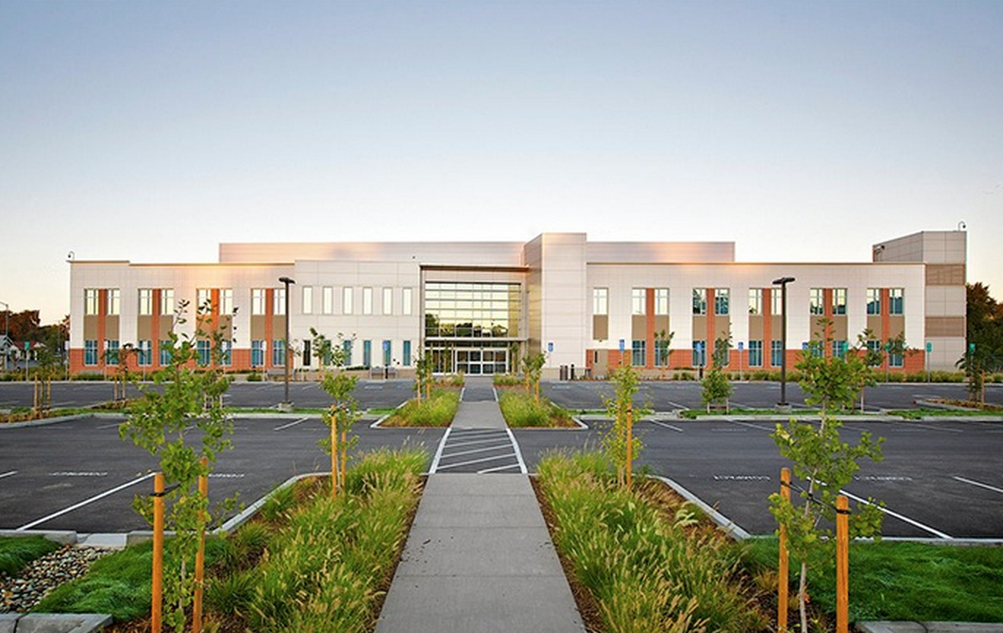
Portfolio
Oakton Community College, Margaret Burke Lee Science and Health Careers Center
Advocate Illinois Masonic Medical Center, Center for Advanced Care
William J. Carroll Government Center

Slide 6
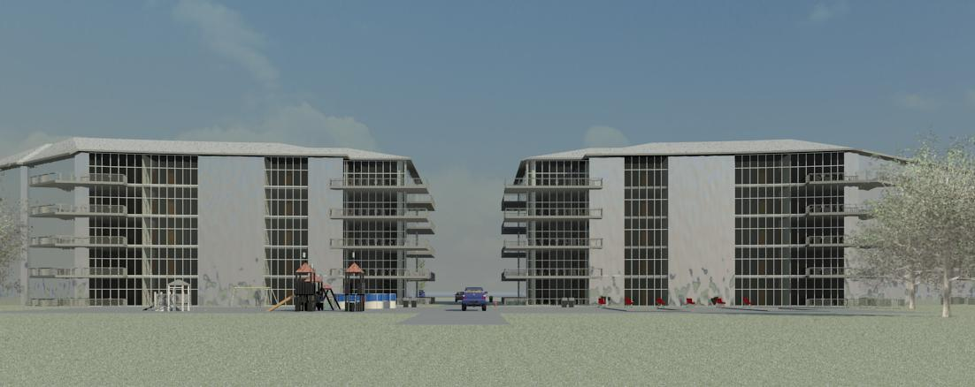
Project Information
Project: Bird Wings
Team A6
Time Keeping:
AutoCAD: 12 Hours
Revit: 60 Hours

Slide 7
Team and Division
Jian Ruan
Community Design &Unit 4
(217)974-5227
Nick Leffert
Unit 1
(615)497-2723
Matthew Lmus
Unit 2
(574)855-8141
Zach Riley
Unit 3
(864)612-8158
Gavin O’Neal
Unit 5
(502)299-4556
Samuel Hathaway
Unit 6
(260)494-7244

Slide 8
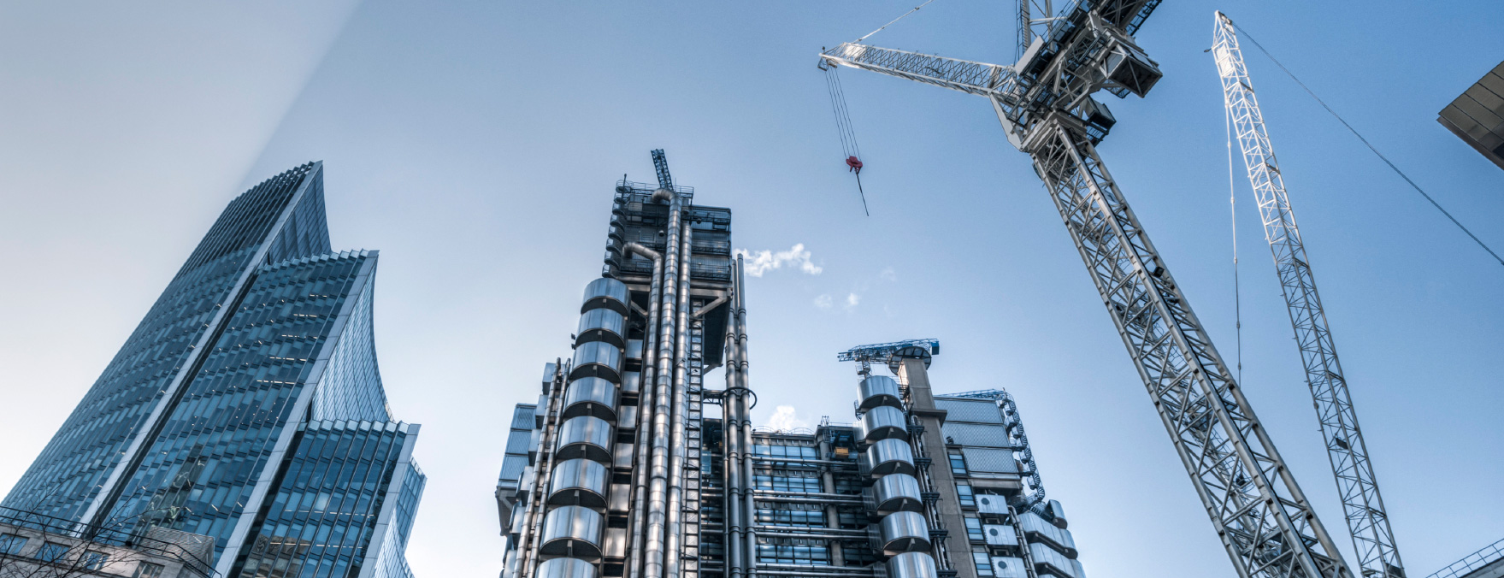
Project Statement
Goal
Create a visually appealing 5-st0ry apartment complex with 6 units, activity center, and landscaping at a reasonable cost that is feasible in the Bay area.
Solution
The design of Bird Wings meets the specifications given and is a visually appealing complex. This building will last for decades to come and will stay in good condition for its duration of use.

Slide 9
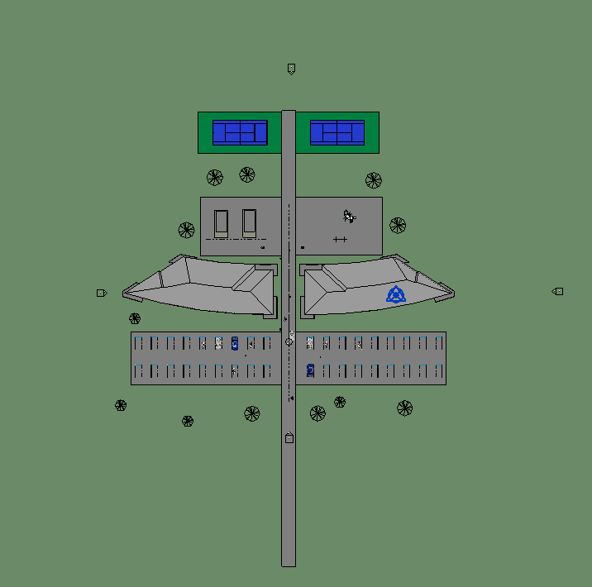
Project Details
Site Overview (REVIT)

Slide 10
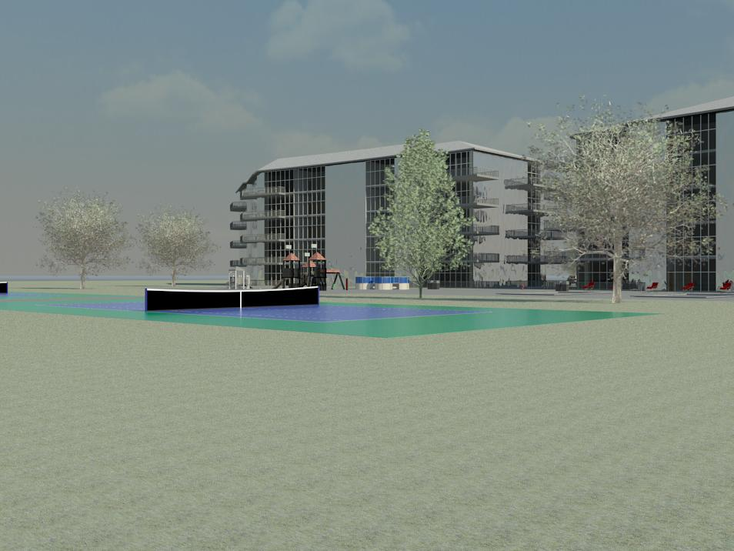
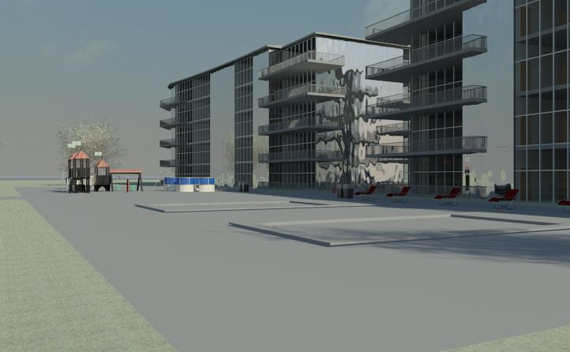
Project Details
Site Overview (REVIT)

Slide 11
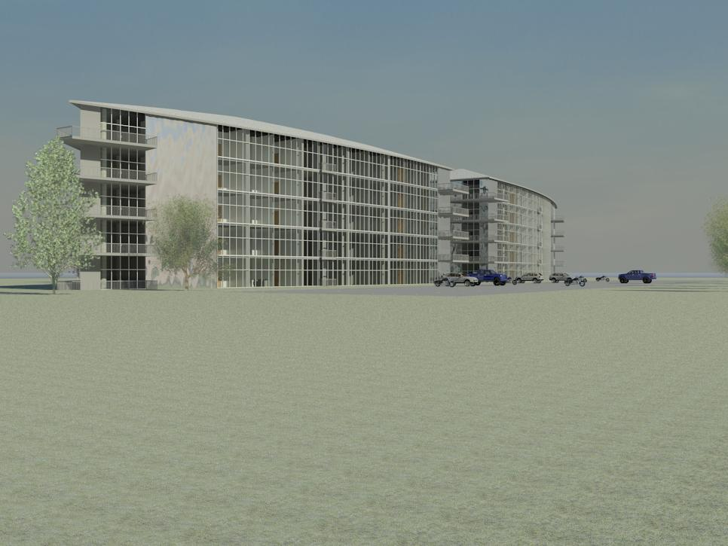
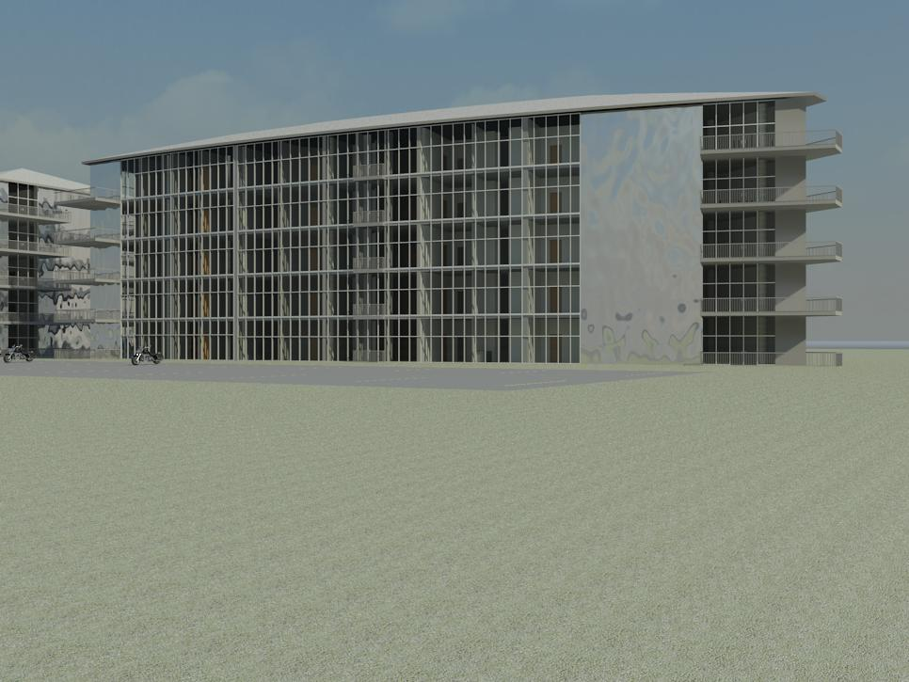
Project Details
Site Overview (REVIT)

Slide 12
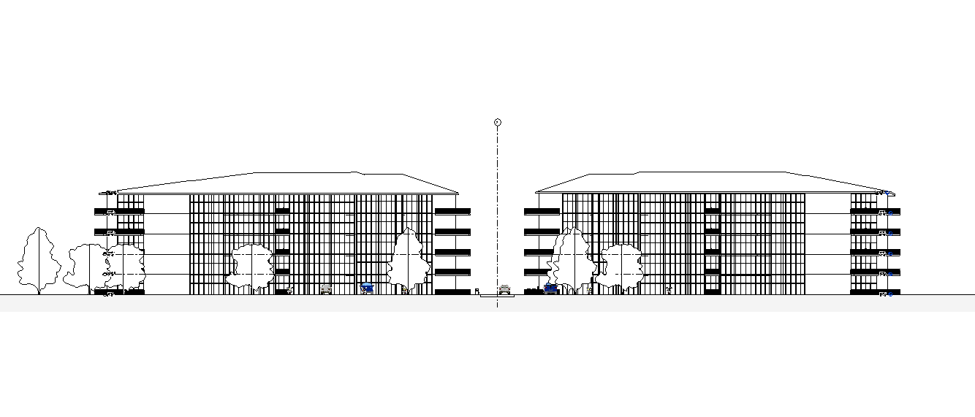
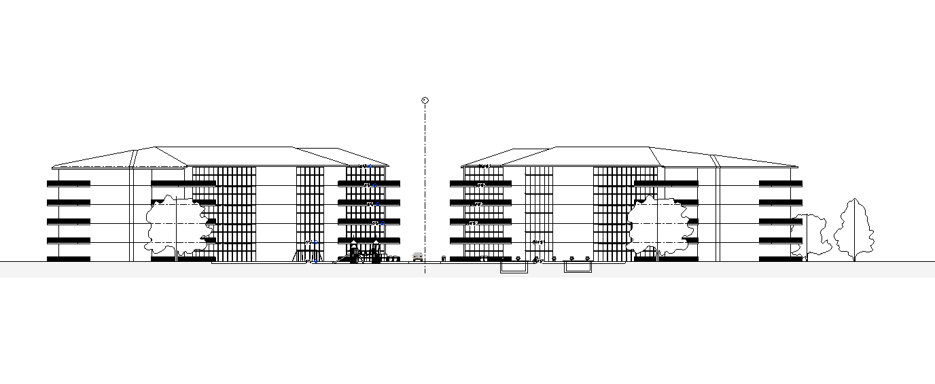
Project Details
Site Overview (REVIT) – Level View
Front
Back

Slide 13
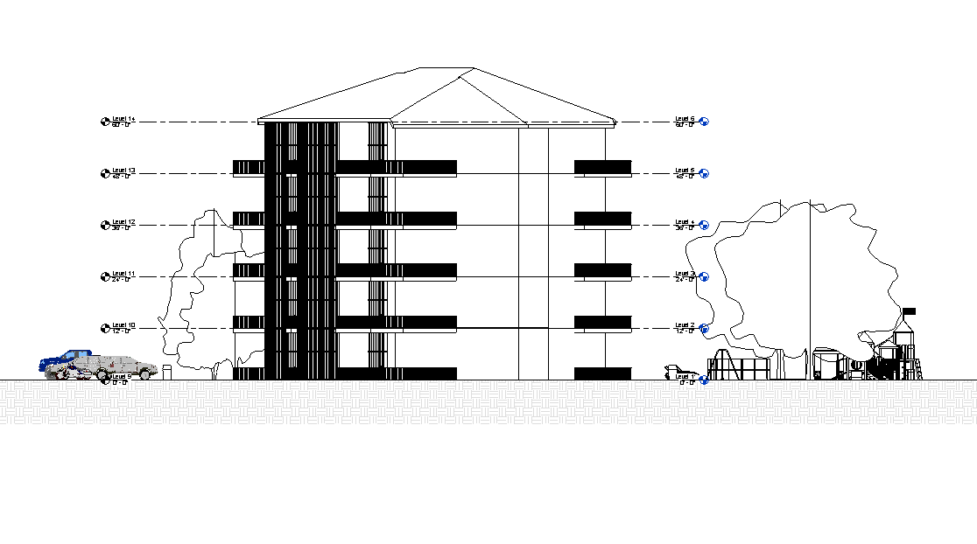
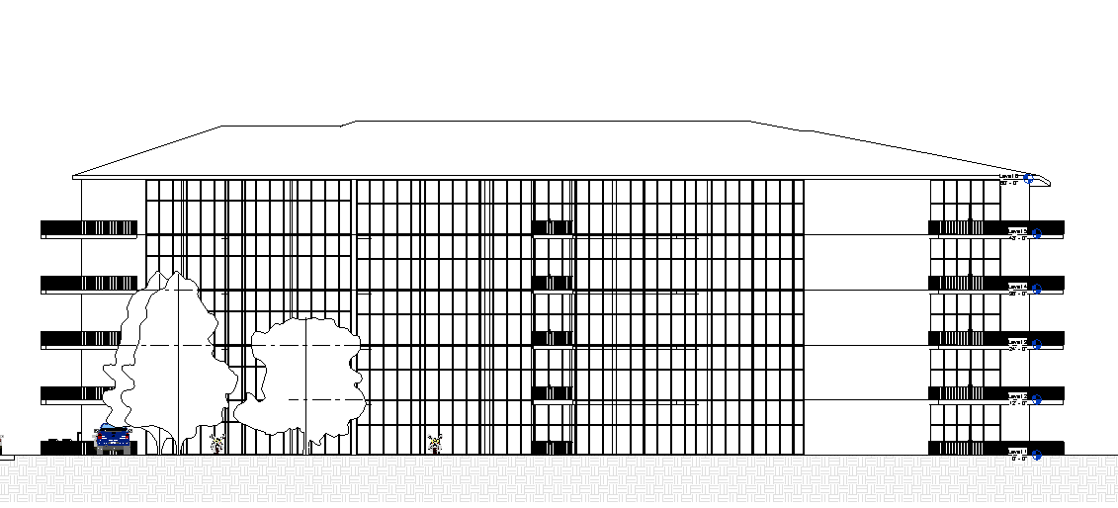
Project Details
Site Overview (REVIT) – Level View
Side
Single Building Front

Slide 14
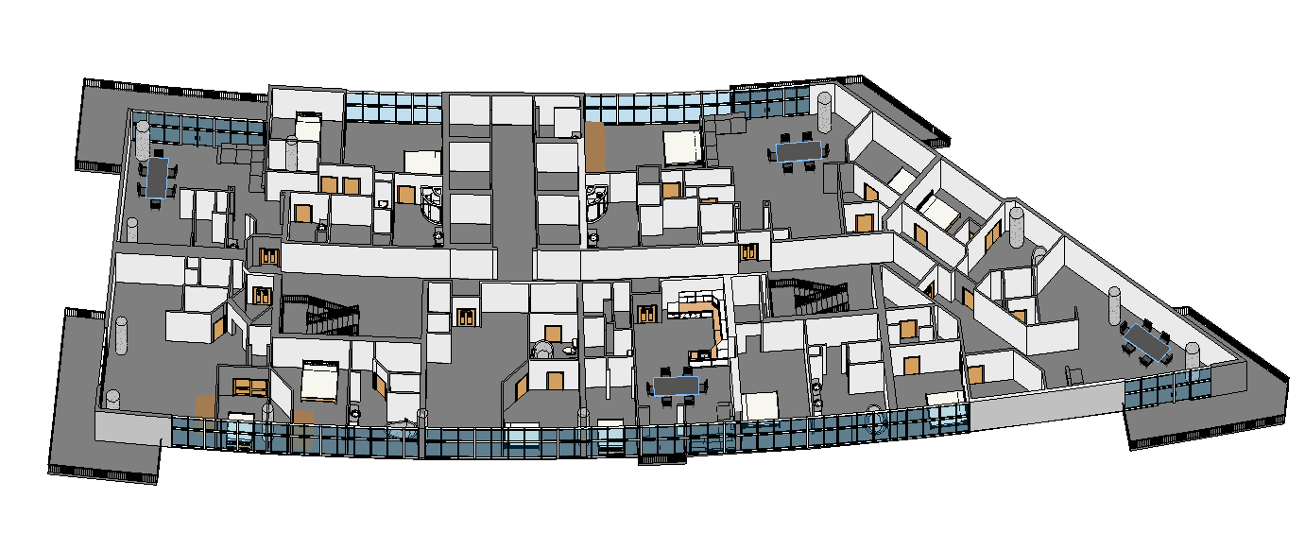
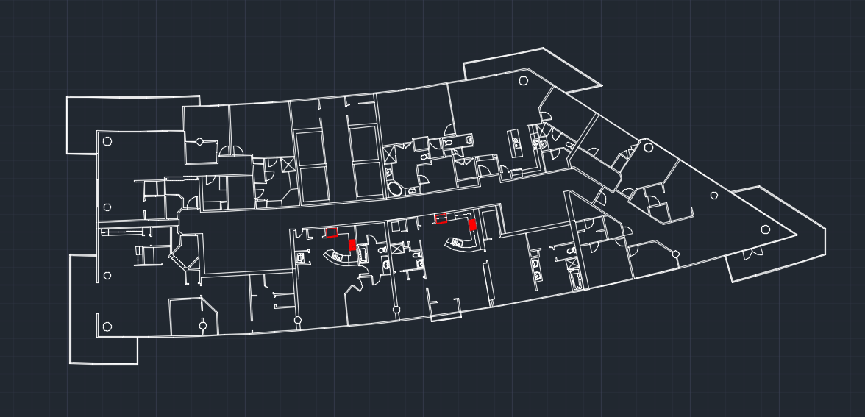
Project Details
Site Overview (REVIT) – Sample Floor Plan
Site Overview (autoCAD) – Sample Floor Plan

Slide 15
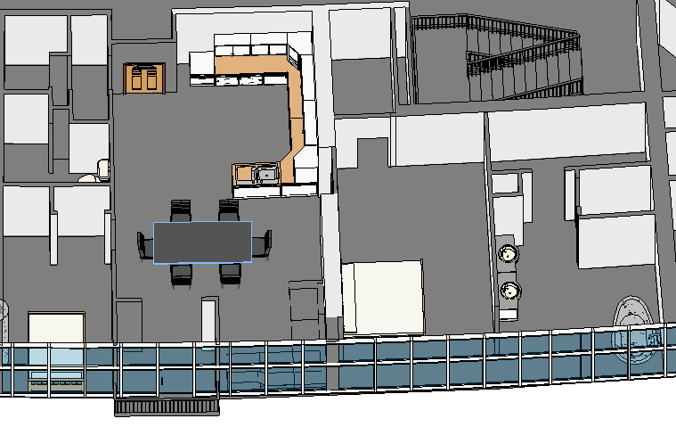
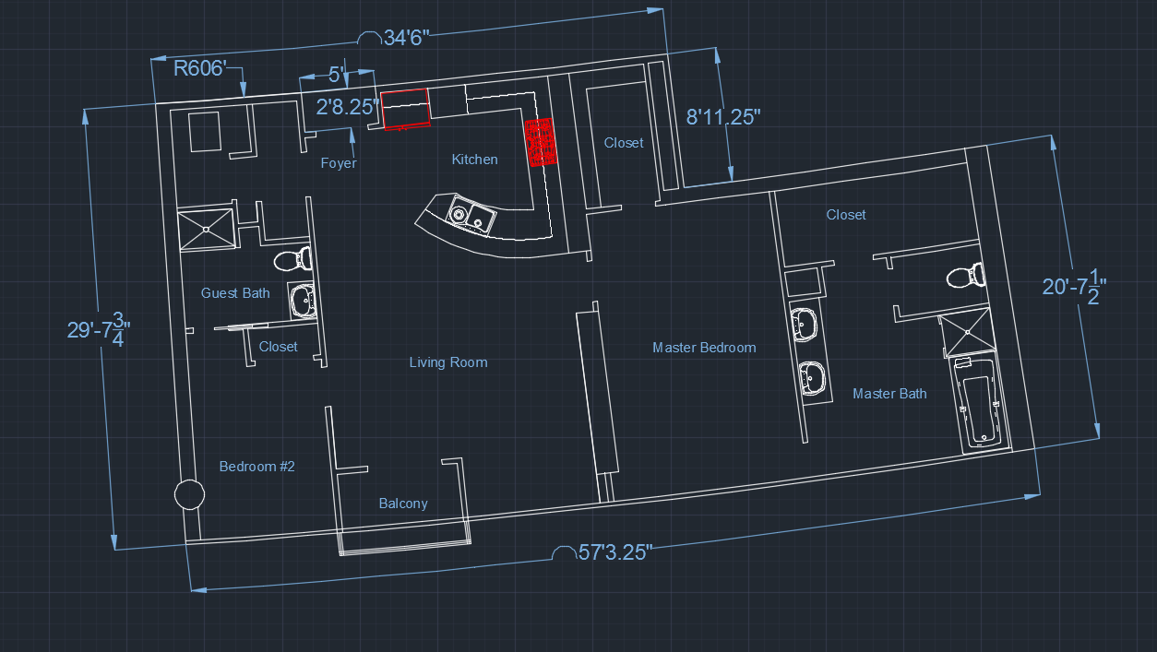
Unit-4 Details
Unit 4 (REVIT)
Unit 4 (AutoCAD)

Slide 16
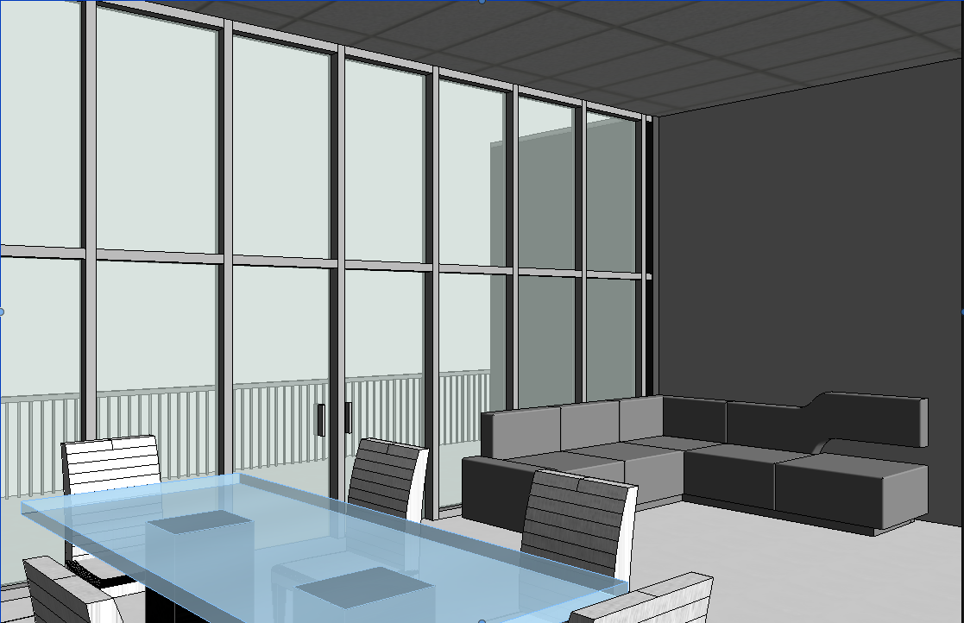
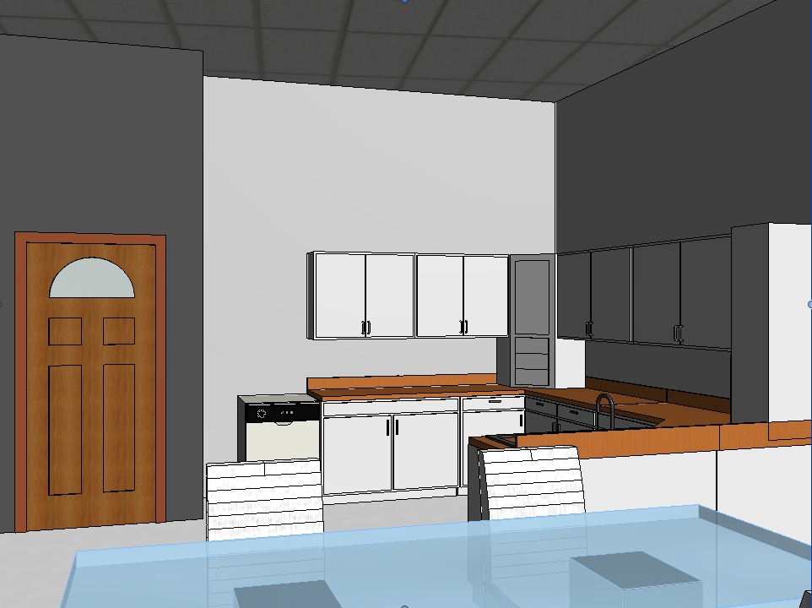
Unit-4 Details
Unit 4 – Living room
Unit 4 – Kitchen

Slide 17
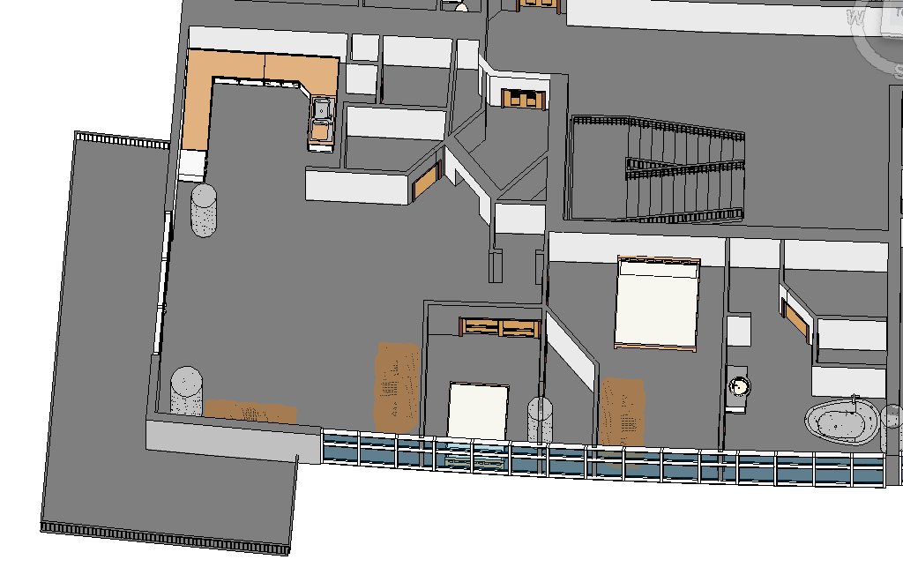
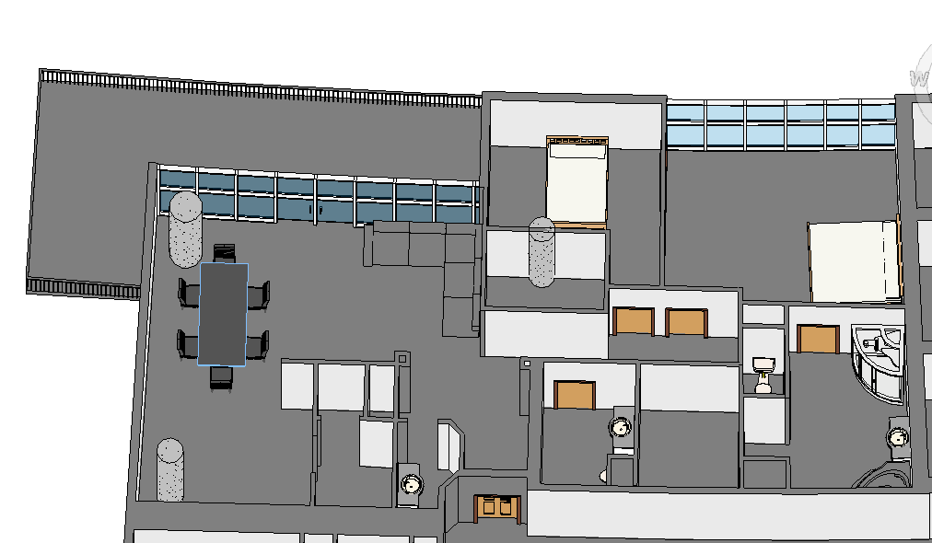
Unit List
Unit 1
Unit 2

Slide 18
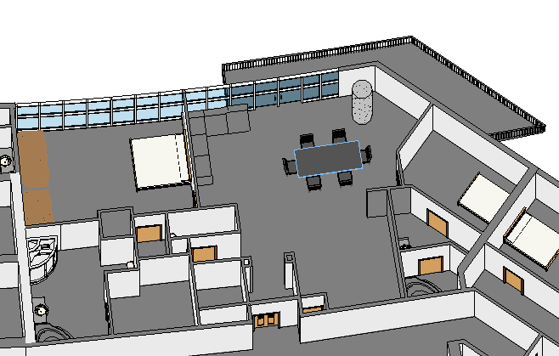
Unit List
Unit 3
Unit 4

Slide 19
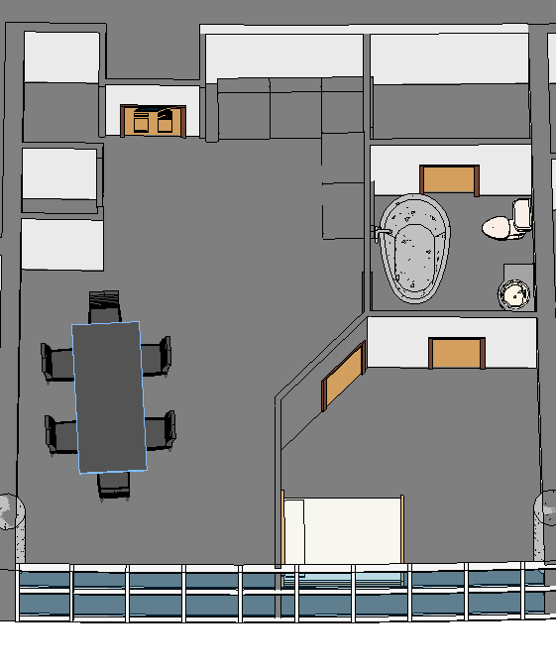
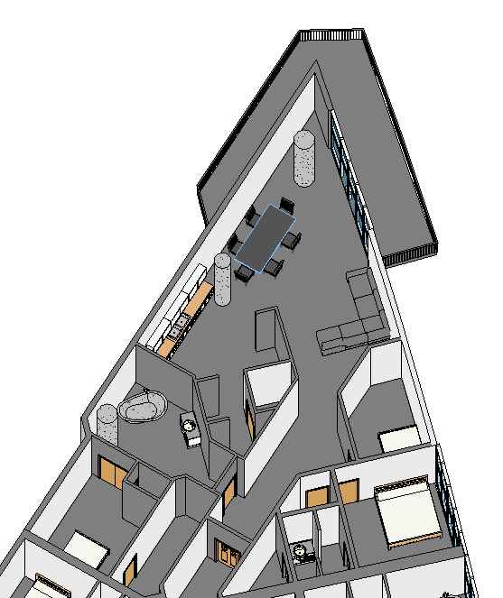
Unit List
Unit 5
Unit 6

Slide 20

Conclusion
Thank you!
Catalyst is always your reliable friend.

